Slide 1
Information Briefing:
Proposed Legislation Supporting 100% Disabled Arkansas Veterans
1

Slide 2
The Arkansas State Veterans Coalition (“AVC”):
Is a non-partisan, not-for-profit organization comprised of Arkansas’ nationally chartered/recognized Veteran Service Organizations (“VSOs”), affiliate veteran and veteran-focused organizations, military, uniformed services, and Regional Veterans Coalitions (“RVCs”) with a common goal to support Arkansas’ 197,000+ veterans and their families.
AVC membership consists of Arkansas affiliates of national and local veteran service organizations and Regional Veteran Coalitions, to include but not limited to the following members:
ABATE 13
Air Force Association, Chapter 253
American Legion
Arkansas County Service Officer Assn
Arkansas Veterans Commission
Combat Veterans Motorcycle Association
Disabled American Veterans
Enlisted Association of Arkansas National Guard
Fleet Reserve Association
River Valley Veterans Coalition
Little Rock AFB Green Knights, Chapter 55
Marine Corps League
Military Officers Association of America
Military Order of the Purple Heart
National Guard Association of Arkansas
Northwest Arkansas Veterans Coalition
Rolling Thunder, Arkansas Chapter 1
Veterans of Foreign Wars
Veterans Outreach Ministries
Western Arkansas Veterans Coalition
North Central Arkansas Veterans Council
Central Arkansas Veterans Coalition

Slide 3
Arkansas Veteran
Demographics

Slide 4
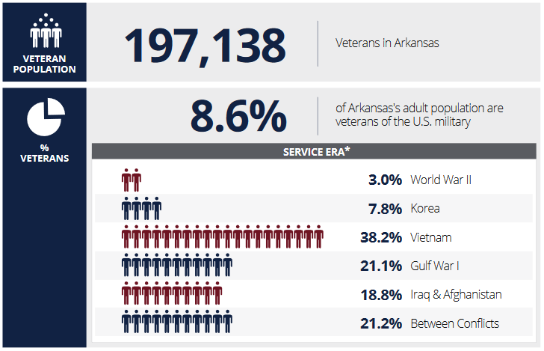
Arkansas Veteran Population - 2022
Source: Census Bureau 2015-2019 American Community Survey
Veterans, their immediate families, and extended families
Are a significant segment of Arkansas’ adult population

Slide 5
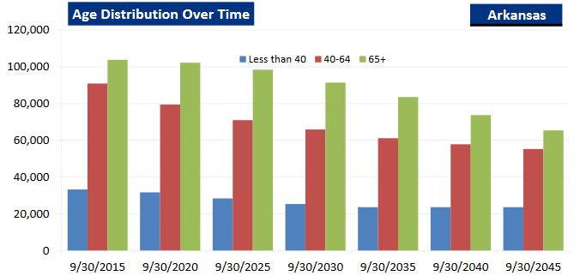
Arkansas Veteran Population – In Decline
Sources: US Department of Veterans Affairs (“VA”), VA Veteran Population Projection Model, VA Geographic Distribution of Expenditures, VA Annual Benefits Report, U.S. Census Bureau, American Community Survey
Over 48% of Arkansas’ 197,138 Veterans are 65+ Years of Age:
75+ - 43,872
65-74 - 51,296
65> Total - 95,168
Source: Census Bureau 2015-2019 American Community Survey

Slide 6
Economic Impact of
Veterans
to
Arkansas’ Economy

Slide 7
US Department of Veteran Affairs FY 2017 Data
*Sources: US Department of Veterans Affairs (“VA”), VA Veteran Population Projection Model, VA Geographic Distribution of Expenditures, VA Annual Benefits Report, U.S. Census Bureau, American Community Survey
FY2022 VA Expenditures**
Total ~ $4.1B
Average per Veteran ~ $18,445
Annual Veteran Economic Impact ***
Total ~ $11.5B
Average per Veteran ~ $51,646
(** Adjusted FY2017 for inflation @ $1/$1.21)
(*** Based on moderate 2.8x Turnover)

Slide 8
Proposed
Legislation

Slide 9
Background
Veterans, certain VSOs, and members of the RVCs in her District contacted Rep. Cindy Crawford (District 51) seeking her help in securing state-level benefits for Arkansas Veterans comparable to those being received by Oklahoma Veterans.
After researching Oklahoma’s benefits and the corresponding enacted legislation, the most significant disparity noted a specific benefit provided to 100% Disabled Veterans.
The specific benefit provided to Oklahoma’s 100% Disable Veterans was exemption from all sales tax, at the point of sale.
Rep. Crawford drafted legislation to secure this benefit for Arkansas Veterans but was not introduced at that time.
Earlier this year, Western and Northwest Arkansas RVCs approached the AVC with the proposed legislation seeking to establish statewide support for the legislation.
At their March 18th, 2022, meeting the AVC unanimously approved support for Legislation providing State Sales Tax Exemption of Arkansas’ 100% Disabled veterans.

Slide 10
Intent – Process
Intent
Limited Exemption for 100% Disable Veterans from the State’s 6.5% Sales tax at the point-of-sale.
Process
Application & Approval:
Veterans submit Exemption Application to DF&A along with requisite documents, to include verification of state residency and US Department of Veterans Affairs Summary of Benefits Letter reflecting 100% Disabled Status.
Upon verification, DF&A issues an “Exempt Veteran ID Card” to the Exempt Veteran and a second ID Card Is issued to their spouse or caregiver. Each ID Card issued for a given Exempt Veteran will have the same unique “DF&A Account Number” so all sales tax exemptions would accrue to the Exempt Veteran’s unique DF&A account.
Exempted Veterans would be limited to a total of $25,000 of State Sales Tax exemptions per year.
State Sales Tax Exemption at Point-of-Sale
Upon purchase of goods or services, the Exempt Veteran/Spouse/Caregiver would present the ID Card to the vendor at the time of purchase.
For each individual purchase: the ID information and the exempted State Sales Tax amount for the purchase is reported to DF&A.
DF&A would record each individual purchase transaction and an accrued running total for the year.

Slide 11
Financial Impact to State
Number of 100% Disabled Veterans: ~ 10,000 (declining annually).
Previously, DF&A estimated the annual cost for exemption of ALL sales tax (state, county, & city) would be between $25M year 1 & $32M year 2.
Adjusting DF&A’s previous estimate based on exemption of the 6.5% State Sales Tax only, the estimated annual cost would be ~ $16M year 1 & $21M year 2.
With the current State Revenue Surplus of $1.63B, the cost of this program could readily be funded now and would have nominal and declining annual impact to the State’s annual revenue going forward.

Slide 12
Financial Impact to 100% Disabled Veterans
Veterans with disabilities living in poverty*:
Ages 65+ 48.0%
Ages 35-64 38.8%
Ages 18-34 14.2%
(Note: The above numbers include ALL Disabled Veterans. 100% Disabled Veterans’ poverty rates are higher than Partially Disabled Veterans because they are unable to supplement their disability compensation with full or parttime work.)
Exemption from State Sales Tax will have a dramatic direct positive financial impact on 100% Disabled Veterans and their families.

Slide 13
Non-Financial Considerations
Every Veteran is someone who “wrote a blank check” payable to America for any amount up to and including their life.
Although 100% Disabled Veterans may not have paid the ultimate price like the heroes that died serving America, they are “paying the steep price” of a lifetime of suffering and pain, a significantly diminished quality of life, an almost certainly a shortened lifespan, and many do this while struggling with serious financial needs due to their disability.
Our nation is reliant upon an all-volunteer military. When young men and women see veterans that have honorably served are suffering and struggling after honorably serving their nation, will they continue to volunteer?
__________________________________________
This is not a money issue, it is a priority issue
Where does our Governor and Legislature rank the 100% Disabled Veterans’ need for meaningful financial relief in the priority of the utilization of the State’s $1.63B Surplus?

Slide 14
What are we asking of you?
To act on behalf of the 197,000 Arkansas Veterans to:
Ask the Governor to include proposed legislation in the August 8th Special Session to provide Arkansas’ 100% Disabled Veterans limited exemption of the 6.5% State Sales Tax At-The-Point of Sale.
In the event the Governor opts to not include such proposed legislation, exercise the Legislature's authority to introduce and pass the proposed legislation. *
* The Legislature has the authority to introduce legislation outside of the specific agenda set by the Governor by passing a resolution by 2/3’s vote in each chamber allowing consideration of “new business”.

Slide 15
Mark Diggs
Arkansas Veterans Coalition
Vice president Pro Tempore
Cell (501)442-1237
Email Mark@DiggsAndAssociates.com
15

